Slide 1
Digital Citizenship
Staying
Safe Online

Slide 2
Students will be able to ...
understand that being safe when they visit websites is similar to staying safe in real life.
learn to recognize websites that are good for them to visit.
recognize if they should ask an adult they trust before they visit a particular website.

Slide 3
What does it mean to be safe?

Slide 4
Key Vocabulary
safe: free from danger or harm
caution: to be careful
right: something that’s appropriate and fitting

Slide 5
When you walk down the street or play in
your neighborhood without a trusted adult
there, how do you stay safe?
Notes:
Gather all responses from students, but highlight these points:
􀂇􀀃Don’t go to places you don’t know
􀂇􀀃Don’t talk to strangers
􀂇􀀃Stay out of trouble
􀂇􀀃Follow the rules
2
STAYING SAFE ONLINE / LESSON PLAN
DIGITAL LITERACY AND CITIZENSHIP IN A CONNECTED CULTURE
© 2012 www.commonsense.org
introduction
Warm-up (5 minutes)
ASK:
What does it mean to be safe? Students’ answers will vary.
DEFINE the Key Vocabulary term safe.
ASK:
When you walk down the street or play in
your neighborhood without a trusted adult
there, how do you stay safe?
Gather all responses from students, but highlight these points:
􀂇􀀃Don’t go to places you don’t know
􀂇􀀃Don’t talk to strangers
􀂇􀀃Stay out of trouble
􀂇􀀃Follow the rules
TELL students that just as they should stay safe in the real world, they should stay safe when they go into the
online world (visiting websites). Make parallels between the answers students gave you about their neighborhood
and the online world.
EXPLAIN to students that one way they can keep safe online is by using the website traffic light. A regular traffic
light tells people who are driving cars when they need to go, slow down, or stop. In the same way, the website
traffic light tells people who are visiting websites whether or not it’s okay to go somewhere.

Slide 6
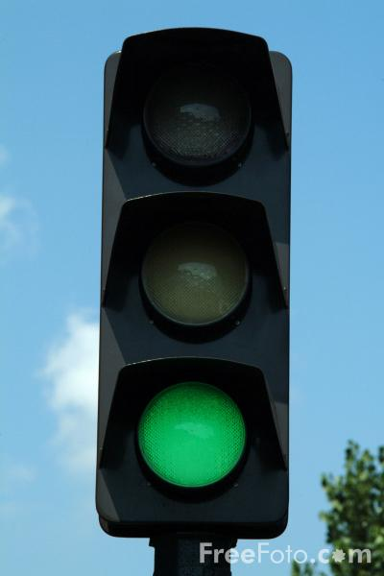
Notes:
DEFINE the Key Vocabulary term right. Explain to students that the website traffic light will help them choose
sites that are just right for them.
EXPLAIN to students the meaning of the green, yellow, and red traffic lights. Use the talking points below.
Green – GOOD!
Look for sites that are “green” and bookmark
them so you can visit your favorites! (You
may have to explain and demonstrate how
to bookmark a site.)A “green” website is:
A good site for kids your age to visit
Fun, with things for you to do and see
Has appropriate words
Doesn’t let you talk to people you don’t know
ASK: What are some “green” websites you visit?
How do you know they’re safe and just right
for you?
Guide students to share websites they visit, exploring how they
are “green” sites.

Slide 7
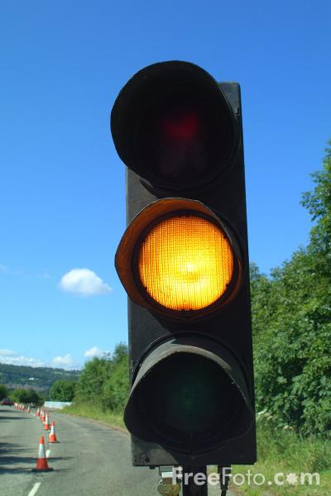
Notes:
Yellow – CAUTION!
Before you go to a site you think is yellow,
get permission from adult you trust.
A “yellow” website is: A site you are not sure is right for you
One that asks for information such as who you are,
where you live, your phone number or email address, etc.
A place where you are allowed to communicate freely
with others
ASK:
Have you ever come across a “yellow” site?
How did you take caution?
Guide students to name sites they have encountered
that they were unsure about visiting, and have them share
their experiences.

Slide 8
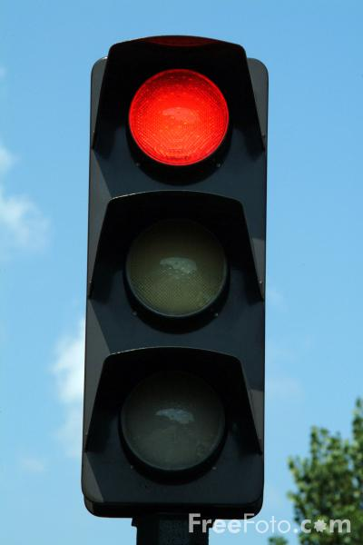
Notes:
Red – STOP!
Avoid a site you think is “red.” If you’re
unsure, ask a trusted adult.
A “red” website is:
A site that is not right for you
A place you might have gone to by accident
Filled with things that are for older kids or adults
ASK:
Have you ever been to a “red” website
you knew was not right for you? How
could you tell?
Guide students to share sites they might have visited that
were inappropriate for them. Keep in mind they may
have visited these sites either deliberately or accidentally.
Students may talk about having a “gut feeling” that tells them
the site is not appropriate for them. Invite them to share
strategies they used to avoid the site, such as clicking the
back button, closing the page, or telling an adult about it.

Slide 9
Website Traffic Light Game
Red - Freeze, no steps
Yellow- Take 1 step
Green- Take 2 steps
Notes:
HAVE students line up in a row on one side of the room. Place a string or piece of tape as a line on the floor on
the opposite side of the room where you’ll stand, parallel to the students’ row. You’ll be playing a game similar to
the popular “Red Light, Green Light” children’s game.
INTRODUCE students to the rules of the game:
For each green website, you move forward two steps.
For each yellow site, you move forward one step.
For each red site, you can’t move.
If you get an answer wrong (i.e., you move the wrong amount of steps), you must go back to where
you stood before and take one step back.
READ ALOUD each of the following statements about pretend websites students might visit. After each statement,
students take the amount of steps they think is correct. Reveal the correct answer after each statement, prompting
students to explain why something is red, yellow, or green. The students who make it to the line at the front of
the room first are the winners.

Slide 10
You went to the games-o-rama website
by accident and a stranger asks you your
name and age.
Notes:
RED – no steps

Slide 11
The Wacky Bunny site is funny! Even your
grandma would think it’s just right.
Notes:
GREEN – forward two steps

Slide 12
You are searching for pictures of
hearts but come across a site that
makes you feel uncomfortable.
Notes:
RED – no steps

Slide 13
A site for your favorite TV show has fun
things for kids your age to do.
Notes:
GREEN – forward two steps

Slide 14
There’s a kids sports site you visited that
allows people to chat with each other.
Notes:
YELLOW – forward one step

Slide 15
You’re on a game site where a screen pops
up and asks for your email address.
Notes:
YELLOW – forward one step

Slide 16
Your teacher tells you to visit a site where
you can learn things about giraffes.
Notes:
GREEN – forward two steps
REMIND students after the game that just as they stay safe by following traffic lights, they should aim to stay
safe online by choosing sites that are just right for them. They should also ask an adult for permission to visit a
site they think is yellow, and avoid visiting sites that are red.
STAYING SAFE ONLINE / LESSON PLAN
DIGITAL LITERACY AND CITIZENSHIP IN A CONNECTED CULTURE
© 2012 www.commonsense.org

Slide 17
Go, Caution, Stop!
Color the traffic light for each statement:
This site is just right for me.
I should get permission from an adult I trust.
There are fun things for me to do and see.
This site is not right for me.
I’d like to go there, but I should be cautious.
The site has things for older kids or adults, but not for me.
Notes:
DISTRIBUTE the Website Traffic Light Student Handout, one per student.
READ ALOUD the handout instructions. Have students work together in pairs or small groups to complete
the handout.
INVITE students to share answers to each statement on the handout. The correct answers are:
1. This site is just right for me. (GREEN)
2. I should get permission from an adult I trust. (YELLOW)
3. There are fun things for me to do and see. (GREEN)
4. This site is not right for me. (RED)
5. I’d like to go there, but I should be cautious. (YELLOW)
6. The site has things for older kids or adults, but not for me. (RED)

Slide 18
Wrap Up
How is staying safe in your neighborhood
and staying safe online similar?
Notes:
Guide students to explain the similarities. For instance,
in both worlds they don’t talk to strangers, don’t go places
they’re not familiar with, and stay out of trouble.

